Slide 1

Department of CSE- Data Science
1st Mini Project Presentation
Project Name: Adaptive Memory Lifecycle Management for Long-Running Agentic AI Systems
By: Group-26
Prince Kumar
Kartikey
Mohd. Uzair

Slide 2

Introduction
Methodology with flow diagram
Complete implementation
Research Paper 1 status- Certificate
Research Paper 2 Status - Acceptance
Reference
Title
Adaptive Memory Lifecycle Management for Long-Running Agentic AI Systems

Slide 3
Introduction
Methodology with flow diagram
Complete implementation
Research Paper 1 status- Certificate
Research Paper 2 Status - Acceptance
Reference
Problem Statement
Existing Agentic AI systems cannot efficiently manage long-term memory, making them less accurate, slower, and harder to scale over time.
Key Challenges
Limited Context: Cannot remember all past interactions.
Static Memory: Stores everything without proper organization.
Poor Retrieval: May fetch irrelevant memories.
Duplicate Data: Similar memories are stored repeatedly.
No Prioritization: Important and unimportant memories are treated the same.
No Intelligent Forgetting: Outdated memories are never removed.
No Compression: Repetitive information is not summarized.
Low Memory Quality: No check for accuracy or usefulness.
Scalability Issues: Larger memory increases cost and response time.
Limited Adaptability: Memory does not improve from user feedback or experience.

Slide 4
Introduction
Methodology with flow diagram
Complete implementation
Research Paper 1 status- Certificate
Research Paper 2 Status - Acceptance
Reference
Proposed Topic
Adaptive Memory Lifecycle Management for Long-Running Agentic AI Systems
Objective
Develop an adaptive memory framework that stores, retrieves, prioritizes, compresses, and forgets information to improve long-term AI performance.
Key Features
Smart Storage – Save only useful memories.
Memory Validation – Keep accurate and reliable information.
Priority Ranking – Rank memories by importance and recency.
Context Retrieval – Fetch only task-relevant memories.
Memory Compression – Merge repetitive information.
Intelligent Forgetting – Remove outdated memories.
Adaptive Learning – Improve memory using feedback.
Expected Outcome
Build a scalable, efficient, and reliable memory framework that improves accuracy, reasoning, personalization, and response speed in long-running AI agents.

Slide 5
Introduction
Methodology with flow diagram
Complete implementation
Research Paper 1 status- Certificate
Research Paper 2 Status - Acceptance
Reference
Why This Topic?
As Agentic AI systems become more autonomous, efficient memory management is essential for building reliable and scalable AI agents.
Why This Research Matters
Growing Adoption – Long-running AI agents are becoming common.
Limited Context – LLMs cannot remember everything.
Memory Bloat – Continuous storage reduces efficiency.
Poor Retrieval – Irrelevant memories affect responses.
No Intelligent Forgetting – Outdated memories remain stored.
Scalability Issues – More memory increases cost and latency.
Research Gap – Adaptive memory lifecycle is still underexplored.
Real-World Impact – Improves accuracy, reasoning, and personalization.

Slide 6
Introduction
Methodology with flow diagram
Complete implementation
Research Paper 1 status- Certificate
Research Paper 2 Status - Acceptance
Reference
Literature Review / Existing Work
Paper | Key Contribution | Limitation
MemGPT (Packer et al., 2023) | Introduced external memory for LLMs. | No adaptive memory lifecycle.
Survey of LLM Memory (Zhang et al., 2025) | Reviewed existing memory techniques. | No implementation framework.
Agentic Memory (Yu et al., ACL 2026) | Combined short-term and long-term memory. | No complete lifecycle management.
Memory for Autonomous Agents (Du, 2026) | Analyzed memory architectures and evaluation. | No practical adaptive solution.
Anatomy of Agentic Memory (Jiang et al., 2026) | Proposed memory taxonomy. | Limited focus on adaptive memory.
From Storage to Experience (Luo et al., 2026) | Explained memory evolution. | Survey only, no working framework.
Research Gap:-
Existing research emphasizes memory storage and retrieval, whereas adaptive memory lifecycle management—including validation, prioritization, compression, reflection, archival, and intelligent forgetting—remains largely unexplored.

Slide 7
Introduction
Methodology with flow diagram
Complete implementation
Research Paper 1 status- Certificate
Research Paper 2 Status - Acceptance
Reference
Proposed Methodology
Workflow
Memory Acquisition – Capture user interactions and task results.
Memory Validation – Verify accuracy and remove invalid data.
Memory Classification – Categorize into episodic, semantic, and procedural memory.
Priority Ranking – Rank memories by importance, recency, and usage.
Context Retrieval – Retrieve the most relevant memories for the current task.
Memory Compression – Merge and summarize repetitive memories.
Adaptive Forgetting – Archive or remove outdated and low-value memories.
Continuous Learning – Update memory using user feedback and task outcomes.
Performance Evaluation – Measure accuracy, latency, memory usage, and task success.

Slide 8
Introduction
Methodology with flow diagram
Complete implementation
Research Paper 1 status- Certificate
Research Paper 2 Status - Acceptance
Reference
Proposed Methodology
Fig: Architecture Diagram

Slide 9
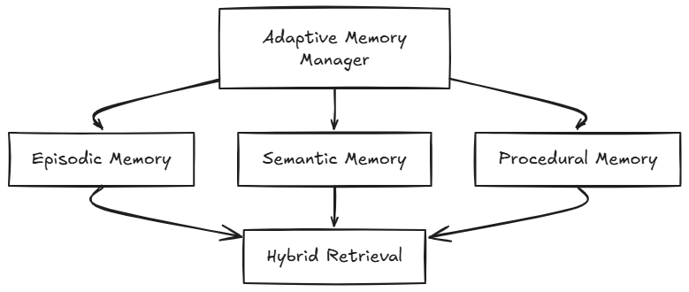
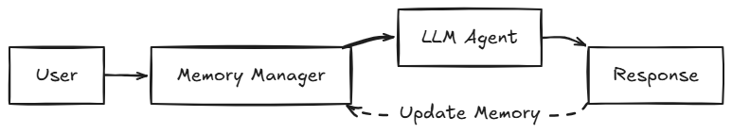
MemFig:Memory Repository Detail
ory Repository Detail
Proposed Methodology
Fig: Memory Repository Detail
Fig: Overall Workflow

Slide 10
Introduction
Methodology with flow diagram
Complete implementation
Research Paper 1 status- Certificate
Research Paper 2 Status - Acceptance
Reference
Expected outcomes
Develop an adaptive memory lifecycle framework that enables efficient, scalable, and reliable long-term memory management for Agentic AI systems.
Key Outcomes
Accurate Retrieval – Fetch the most relevant memories.
Reduced Memory Bloat – Remove duplicate and obsolete data.
Lower Cost – Reduce token usage and storage requirements.
Faster Responses – Improve retrieval speed and latency.
Better Long-Term Reasoning – Retain useful knowledge over time.
Adaptive Learning – Continuously improve using feedback.
Research Contribution – A novel adaptive memory lifecycle framework for future AI systems.

Slide 11
Introduction
Methodology with flow diagram
Complete implementation
Research Paper 1 status- Certificate
Research Paper 2 Status - Acceptance
Reference
Refrences
[1] C. Packer, S. Wooders, K. Lin, V. Fang, S. G. Patil, I. Stoica, and J. E. Gonzalez, "MemGPT: Towards LLMs as Operating Systems," arXiv preprint arXiv:2310.08560, 2023.
[2] Z. Zhang, Q. Dai, X. Bo, C. Ma, R. Li, X. Chen, J. Zhu, Z. Dong, and J.-R. Wen, "A Survey on the Memory Mechanism of Large Language Model-Based Agents," ACM Computing Surveys, vol. 58, no. 4, 2025.
[3] Y. Yu, L. Yao, Y. Xie, Q. Tan, J. Feng, Y. Li, and L. Wu, "Agentic Memory: Learning Unified Long-Term and Short-Term Memory Management for Large Language Model Agents," Proceedings of ACL, 2026.
[4] P. Du, "Memory for Autonomous LLM Agents: Mechanisms, Evaluation, and Emerging Frontiers," arXiv preprint arXiv:2603.07670, 2026.
[5] D. Jiang, Y. Li, S. Wei, J. Yang, A. Kishore, A. Zhao, D. Kang, X. Hu, F. Chen, Q. Li, and B. Li, "Anatomy of Agentic Memory: Taxonomy and Empirical Analysis of Evaluation and System Limitations," arXiv preprint arXiv:2602.19320, 2026.
[6] J. Luo, Y. Tian, C. Cao, Z. Luo, H. Lin, K. Li, C. Kong, R. Yang, and J. Ma, "From Storage to Experience: A Survey on the Evolution of LLM Agent Memory Mechanisms," Findings of ACL, 2026.
[7] S. Yao, J. Zhao, D. Yu, N. Du, I. Shafran, K. Narasimhan, and Y. Cao, "ReAct: Synergizing Reasoning and Acting in Language Models," International Conference on Learning Representations (ICLR), 2023.
[8] L. Wang, Y. Ma, R. Zhang, Y. Yang, J. Shu, Z. Chen, et al., "A Survey on Large Language Model Based Autonomous Agents," Frontiers of Computer Science, vol. 18, no. 6, 2024.

Slide 12
Thank You

